Slide 1


Mastering Time Management
Time is our most precious asset in our careers and lives. Many struggle with managing it effectively, leading to a massive time management industry. This guide offers simple, transformative approaches to make your workday more productive.
by Burning

Slide 2

The Value of Time
1
Precious Asset
Time is irretrievable. Every minute that passes can't be regained.
2
Common Struggles
We often waste time by focusing on wrong work or socializing excessively.
3
Industry Response
A massive time management industry has emerged to help people use time effectively.

Slide 3
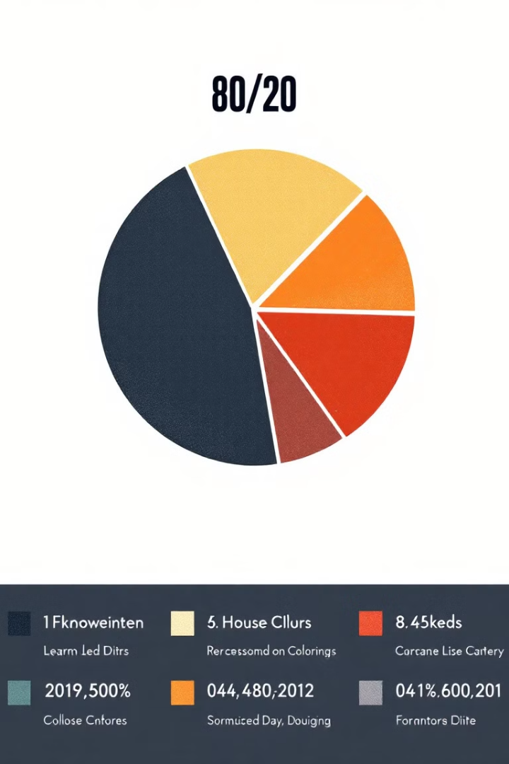
The 80/20 Rule
1
Evaluate Work
Assess each task, person, and project for strategic importance.
2
Categorize
Separate work into 20% strategic tasks and 80% routine tasks.
3
Allocate Time
Spend no more than 50% of your time on the 80% pile.

Slide 4
Managing the 80%
Automate
Delegate
Outsource
Use tools like Microsoft Excel or Access to speed up routine tasks.
Assign tasks to team members, like creating first drafts of presentations.
Find vendors to handle tasks outside your core competencies.

Slide 5

Finding Your Einstein Window
Personal Peak
Identify your daily period of highest mental performance and productivity.
Characteristics
Work feels fun, problems seem manageable, and tasks are completed efficiently.
Timing Varies
This window can occur early, mid-day, or late, depending on the individual.

Slide 6




Protecting Your Einstein Window
Identify
Reflect on when you feel most productive during the day.
Schedule
Plan your most important tasks during your Einstein Window.
Protect
Minimize interruptions and distractions during this crucial time.

Slide 7




Prioritizing Tasks
To-Do List
Review your tasks and identify the most strategic ones.
Timing
Align important tasks with your Einstein Window for maximum productivity.
Focus
Concentrate on the 20% of tasks that yield 80% of results.

Slide 8

Implementing Time Management Strategies
Strategy
Benefit
80/20 Rule
Focus on high-impact tasks
Einstein Window
Maximize personal productivity
Task Management
Efficient workload organization

